Slide 1
Making Magic
Introduction to programming JavaScript

Slide 2
Introduction
Joey Madich – Software Engineer
I like coding because I’ve always enjoyed building and making things that I think up in my imagination.
Legos, Forts outside, Model Cars, Rockets outside, Roller Coasters
JavaScript is my favorite language.
Harry Potter is one of my favorite stories.
Ranjith Gampa –
I always wanted to be a software engineer because that enables me to simplify things in life.
Java is my favorite language.
Around the Room!

Slide 3
Introduction
What’s your name?
Why did you come to code camp?
What’s your favorite Harry Potter book?

Slide 4
Harry Potter, Magic, JavaScript?
Magic and computer programming are similar…
Your code is like a magic spell, Set of instructions to perform something amazing, repeatable
A small change to a spell can have a big effect (good or bad)!
Seamus and the feather
A small change to code can have the same effect!
Notes:
This is why kids go to Hogwarts and why we have Code Camp as well as study

Slide 5
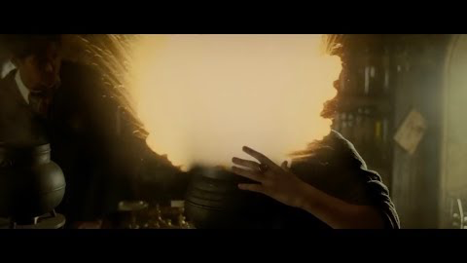

Slide 6
Let’s chat about the web…
What is the web?
What is a network, and what is a server?
What is HTTP?
What is DNS?
How do I get content on the web?

Slide 7
Mischief Managed…
Web Sites
Pages – HTML, CSS, JavaScript
Document Object Model
Messing with Google
Chrome Developer Tools

Slide 8
What is JavaScript?
What are your favorite websites?

Slide 9
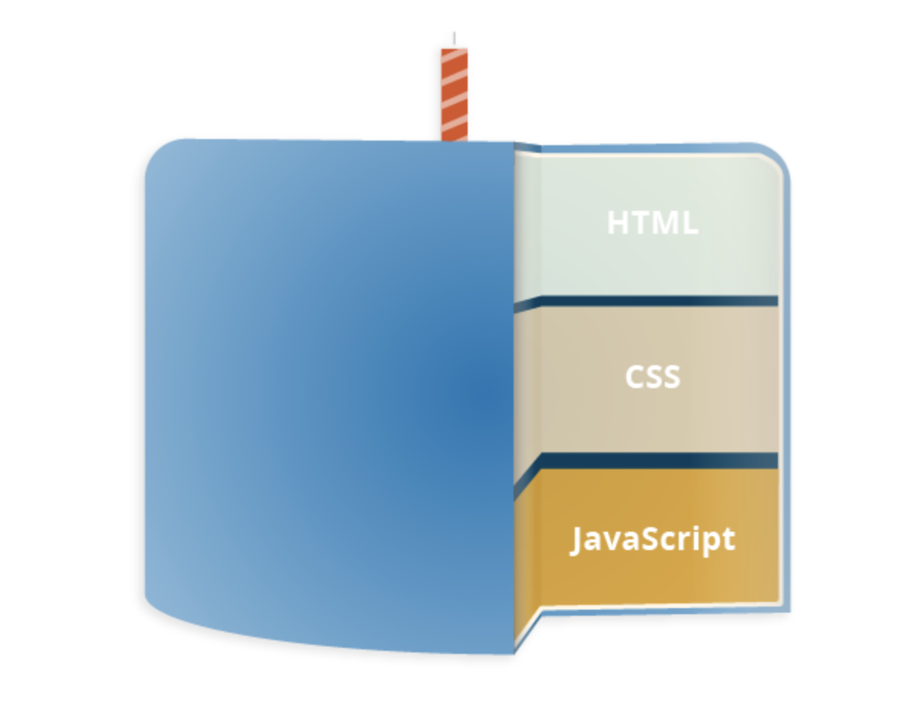
What is JavaScript?
JavaScript is the programming language of the web
Allows you to do amazing things on web pages

Slide 10
Simple Example
<html>
<head>
<script type="text/javascript">
function sayHello() {
alert("Hello World");
}
</script>
</head>
<style>
body {
background-color: blue;
}
</style>
<body>
<input type="button" onclick="sayHello()" value="Say Hello" />
</body>
</html>

Slide 11
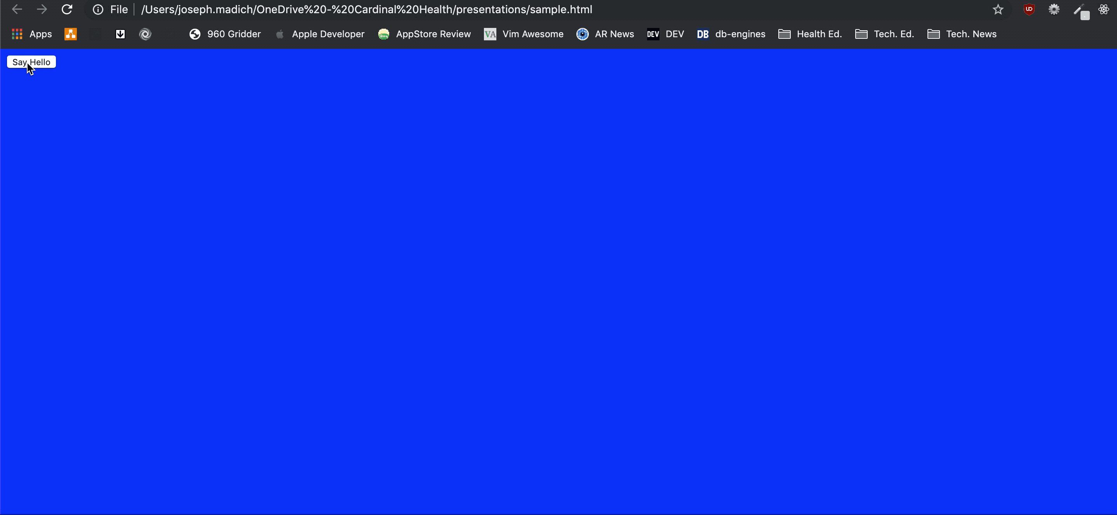
Simple Example

Slide 12
What is JavaScript?
Many large libraries of Magical Javascript.
http://scrollmagic.io
http://alfredservice.com
https://codepen.io/natewiley/full/HBrbL
https://codepen.io/giana/full/GJMBEv

Slide 13
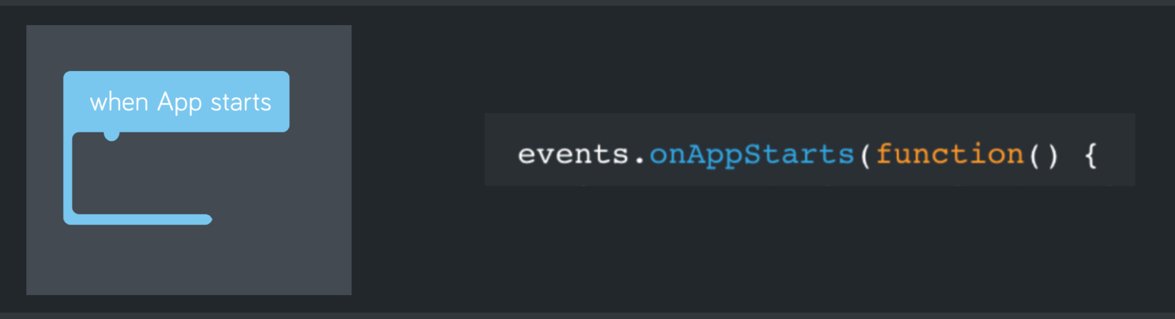
Functions & Events
The heart of how JavaScript works
Functions: are actions, describe something to do
Events: are special functions that also describe a response when the original action completes.

Slide 14
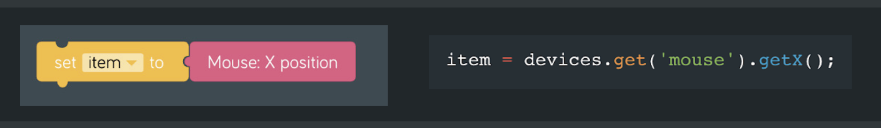
Variables
Temporary, named places to put information.
Set it aside until I need it, and I can change it any time.

Slide 15
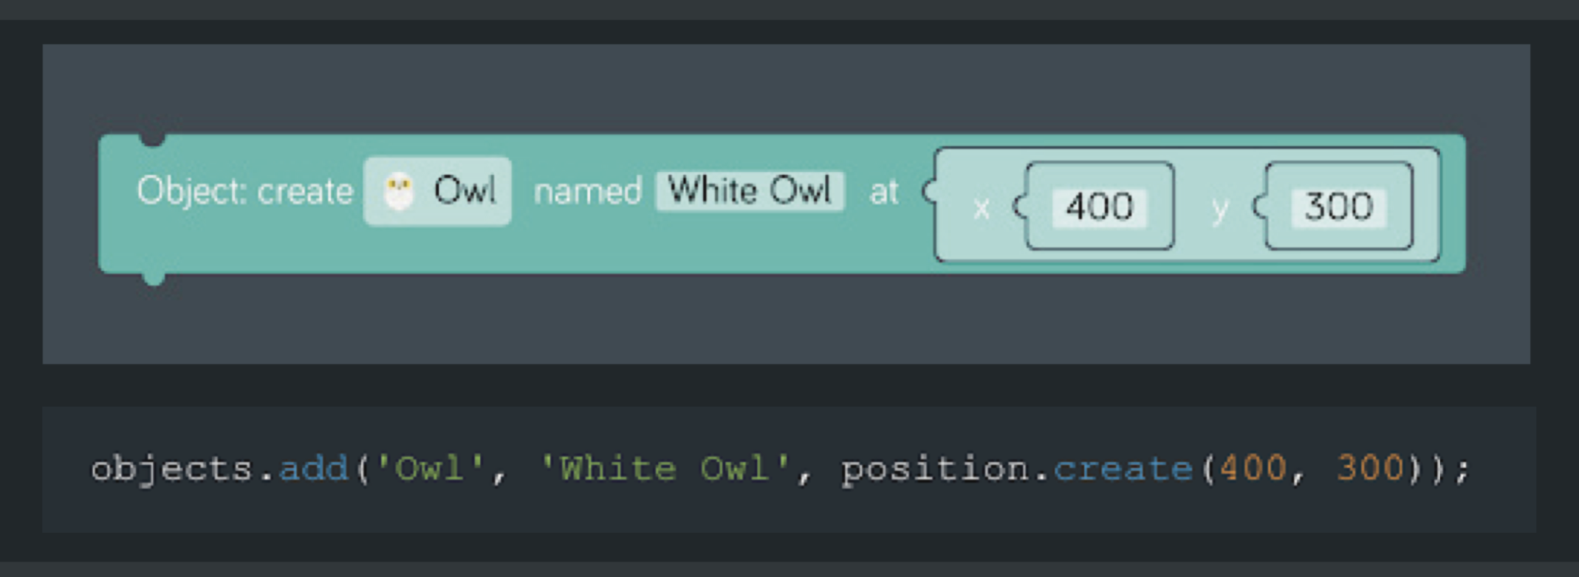
Parameters
Parameters are information given to a function to help it do what it’s supposed to do.
Like magic words given to a spell!

Slide 16
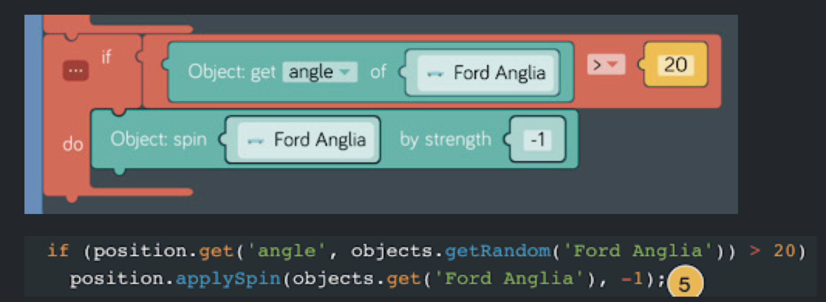
Conditionals & Loops
Reasons and ways for us to tell our functions what to do if something is true
Loops are conditionals to do repetitive operations until something is true

Slide 17
Objects
A purposeful collection of variables and functions
Example:
Harry (Object)
Harry is tired (variable)
yes or no
Harry casts a spell (function)
Whether or not harry is tired (parameter)
Harry can swish his wand up (event)
Magic words (parameter)
If harry is not tired (conditional)
Harry casts a spell (function)

Slide 18

Kano
Notes:
Introduce the wand and go through a simple challenge.

Slide 19
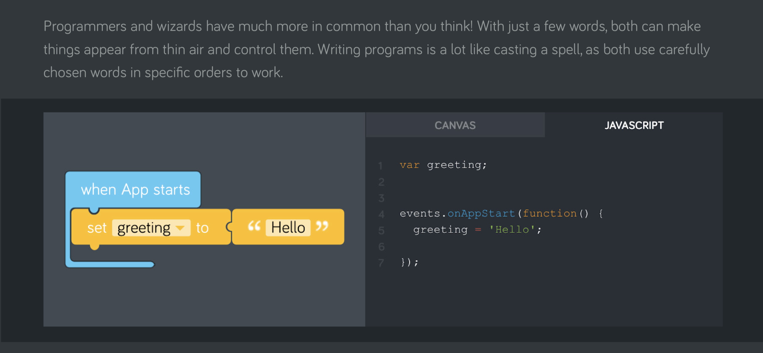
Let’s Get Set Up

Slide 20
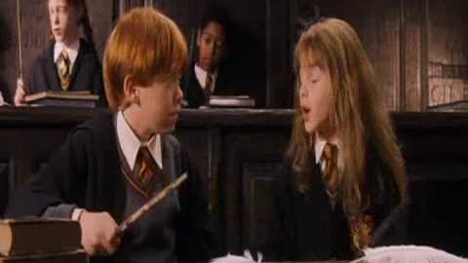
Levitate a Feather
https://hoc-2018.kano.me/challenges/001_hoc_ingardium

Slide 21
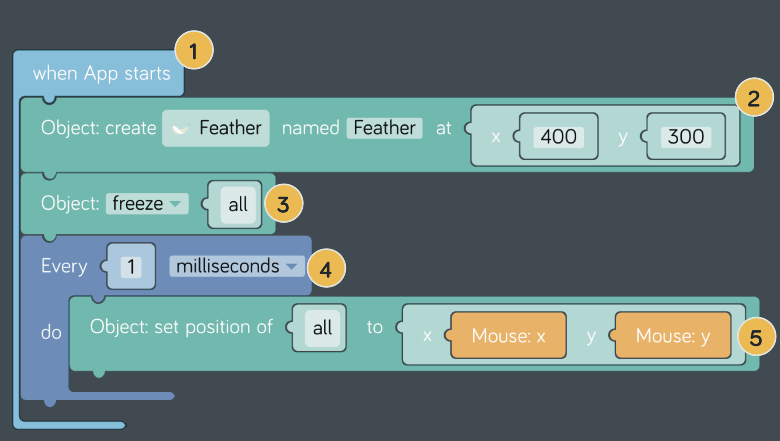
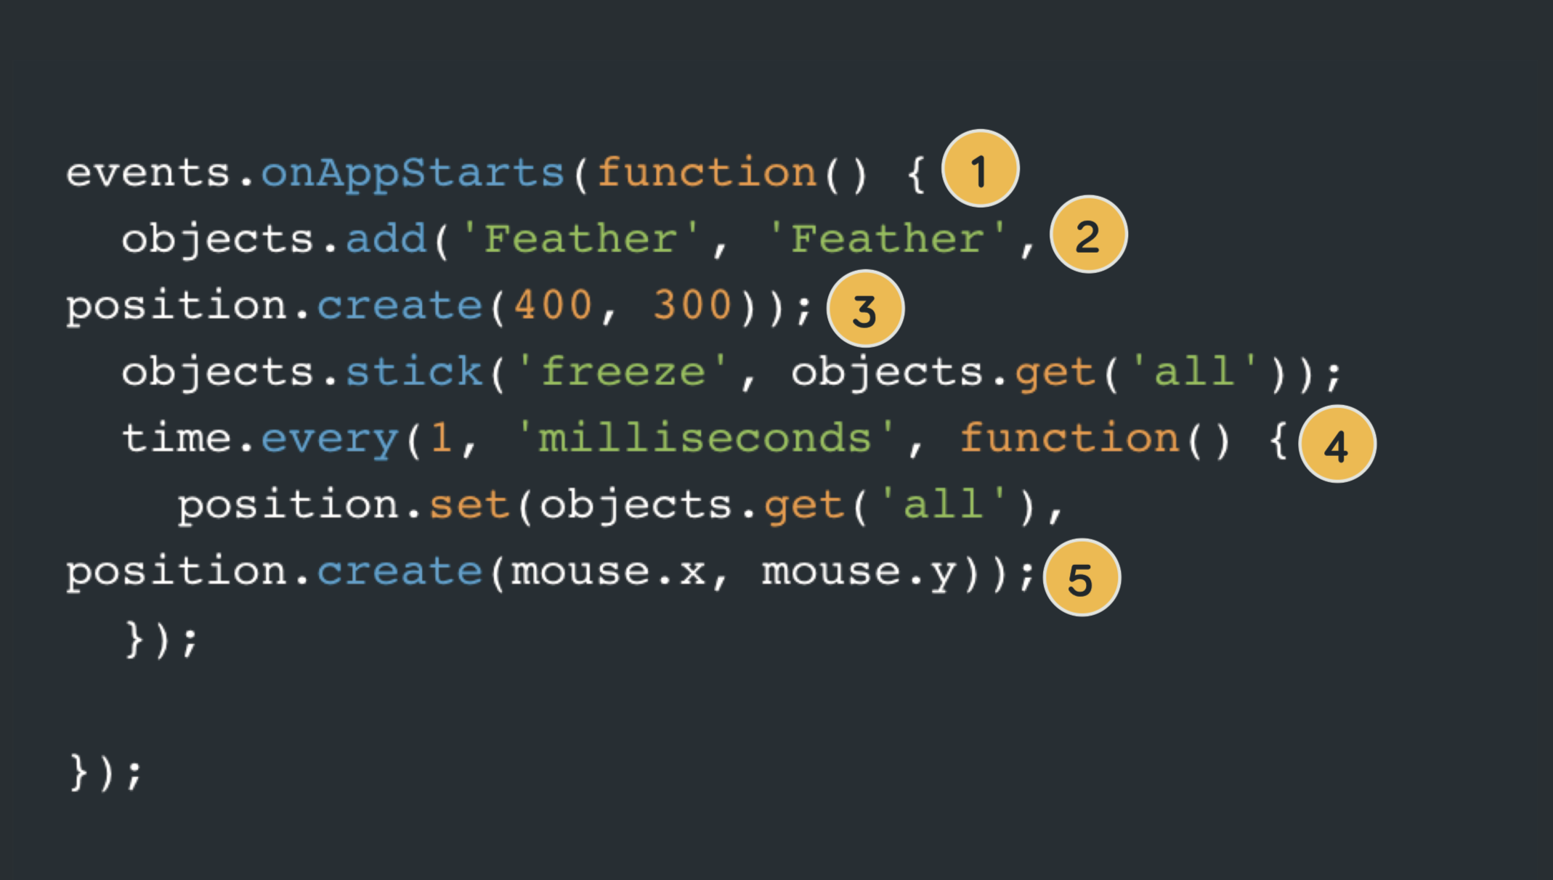
Levitate a Feather

Slide 22
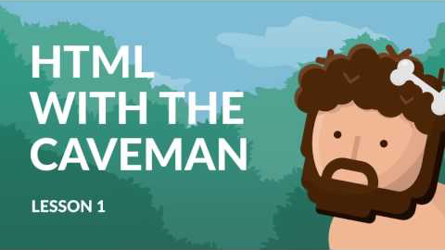
Practical Demo…

Slide 23
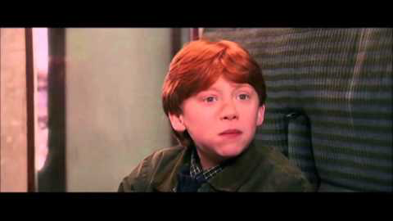
Bertie Bott’s Every-Flavour Beans
https://hoc-2018.kano.me/challenges/002_hoc_beans

Slide 24
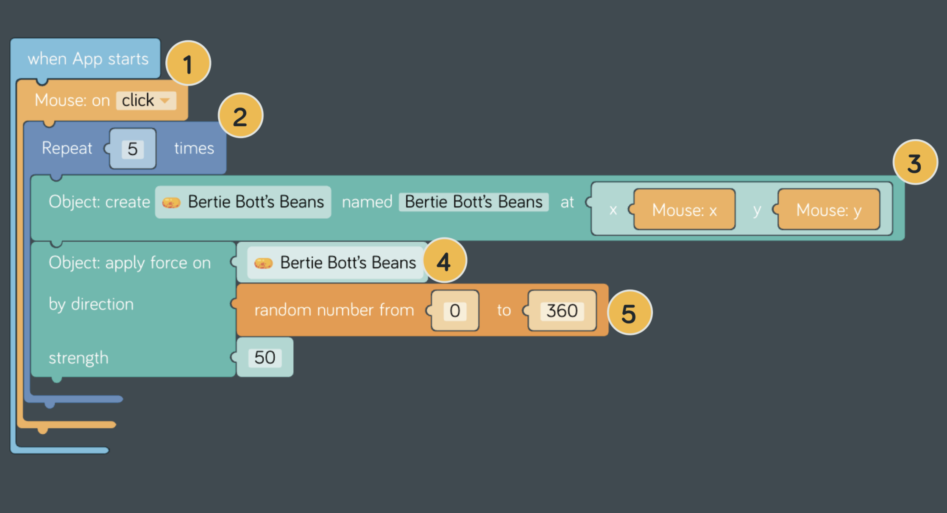
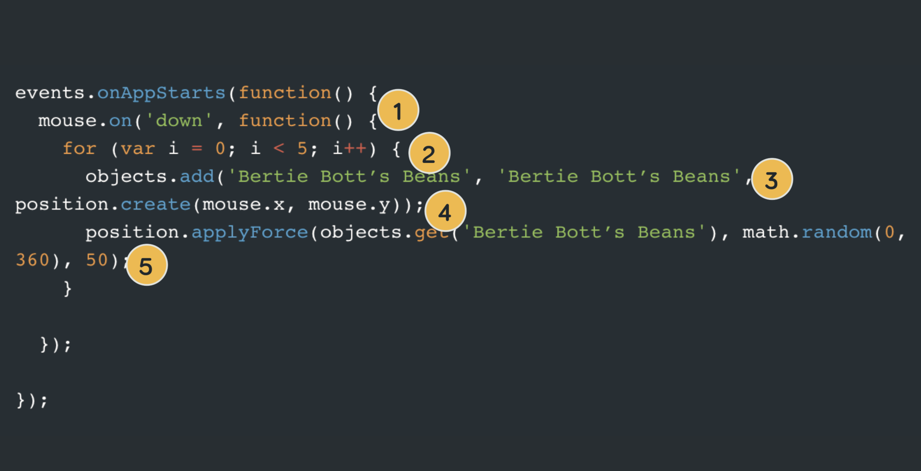
Bertie Bott’s Every-Flavour Beans

Slide 25
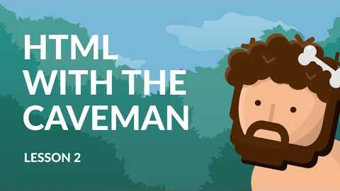
Practical Demo…

Slide 26
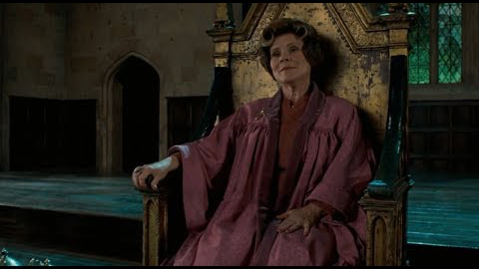
Fireworks that Fizz and Bang
https://hoc-2018.kano.me/challenges/003_hoc_fireworks

Slide 27
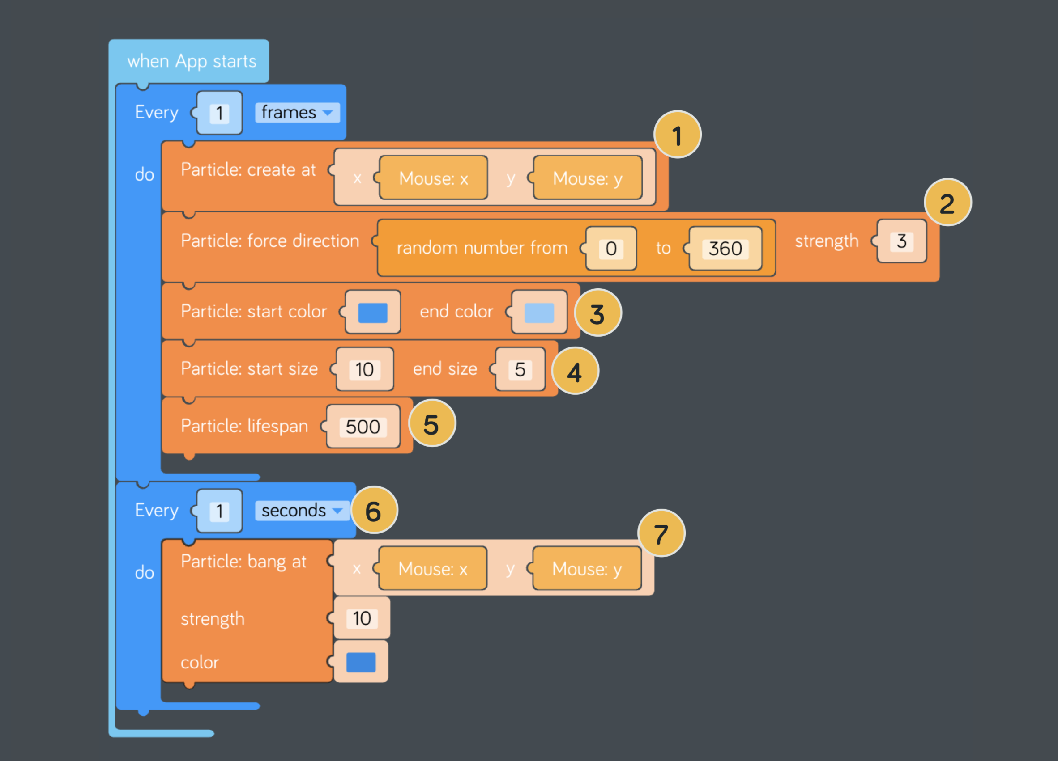
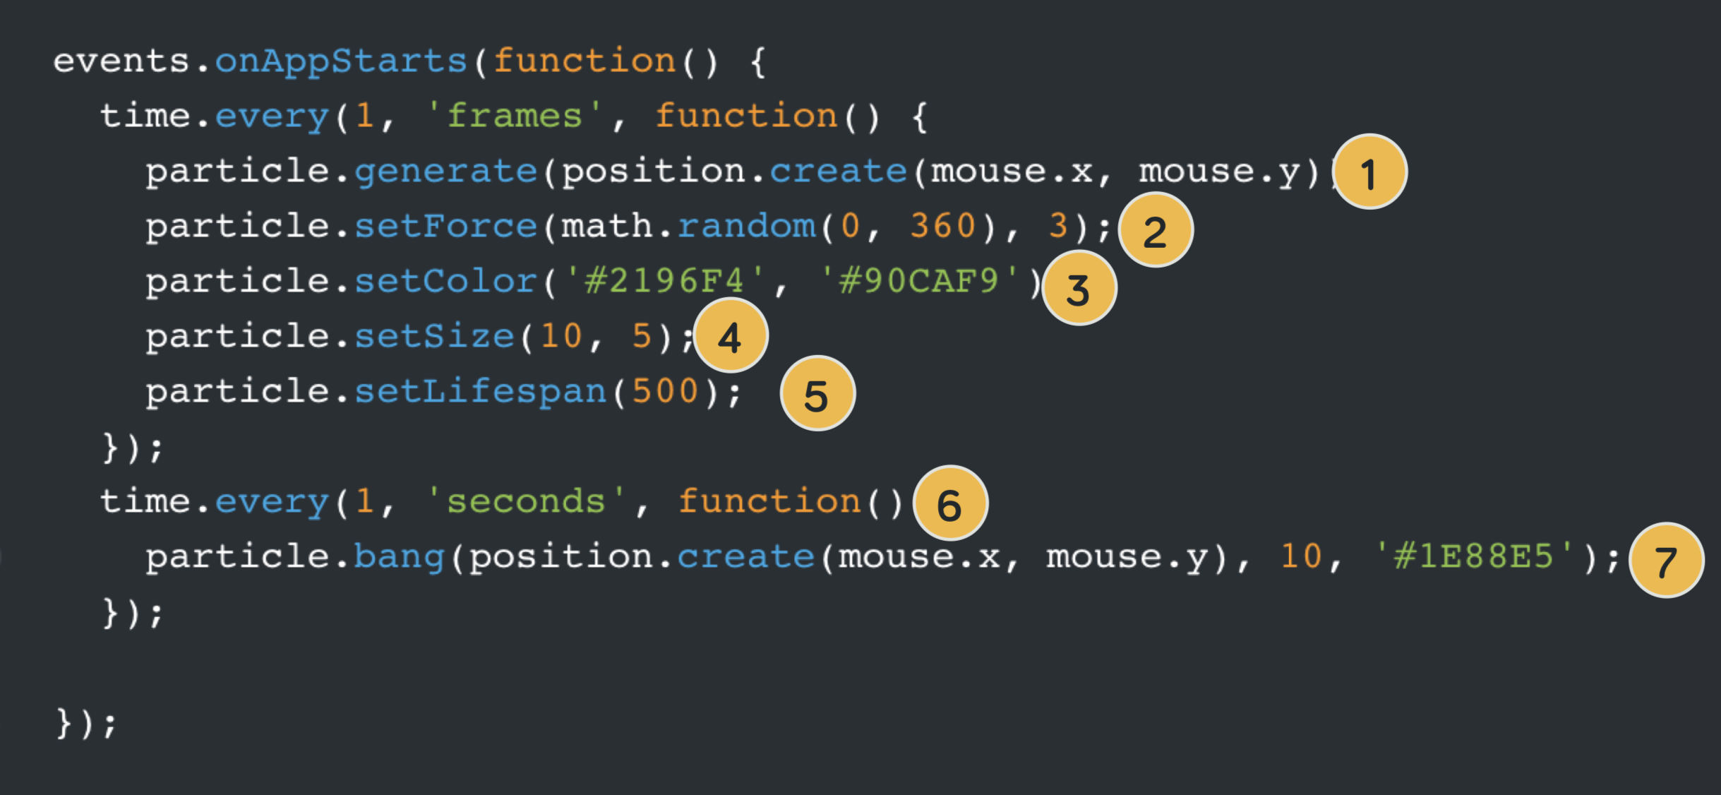
Fireworks that Fizz and Bang

Slide 28
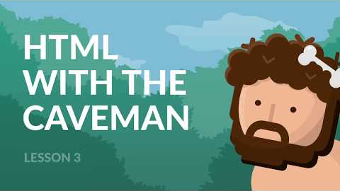
Practical Demo…

Slide 29
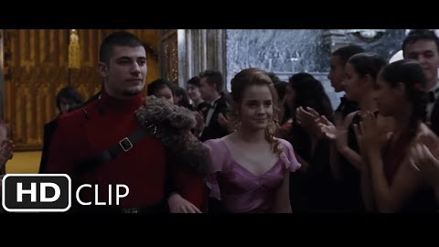
Control Music
https://hoc-2018.kano.me/challenges/004_hoc_music

Slide 30
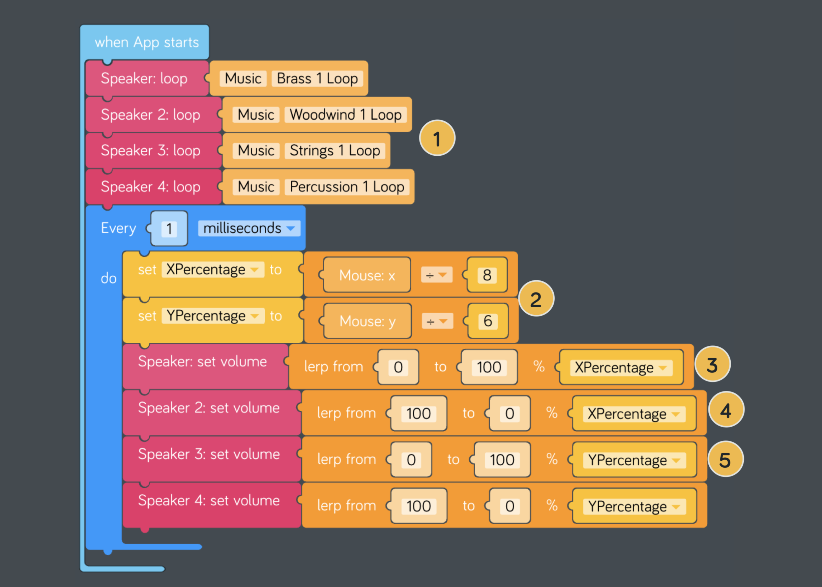
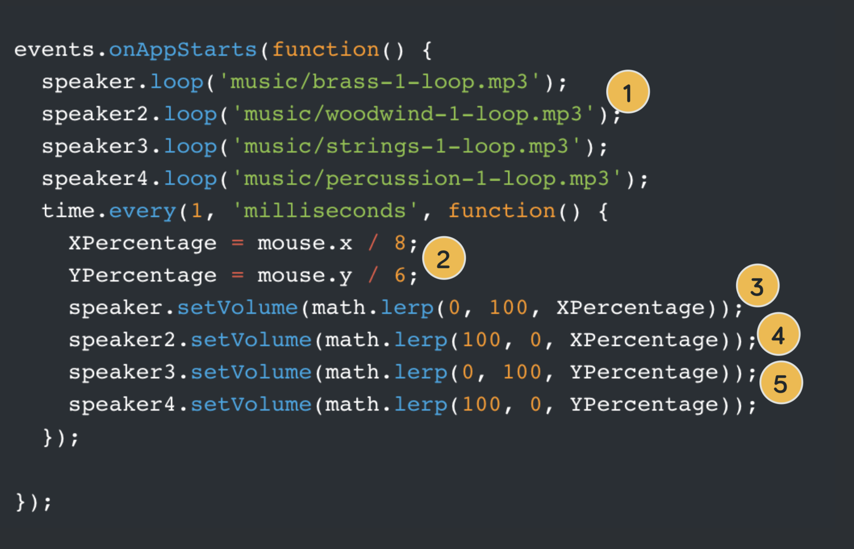
Control Music

Slide 31
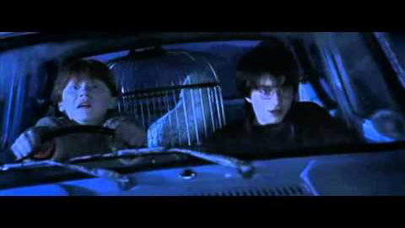
Control the Flying Car
https://hoc-2018.kano.me/challenges/005_hoc_fly

Slide 32
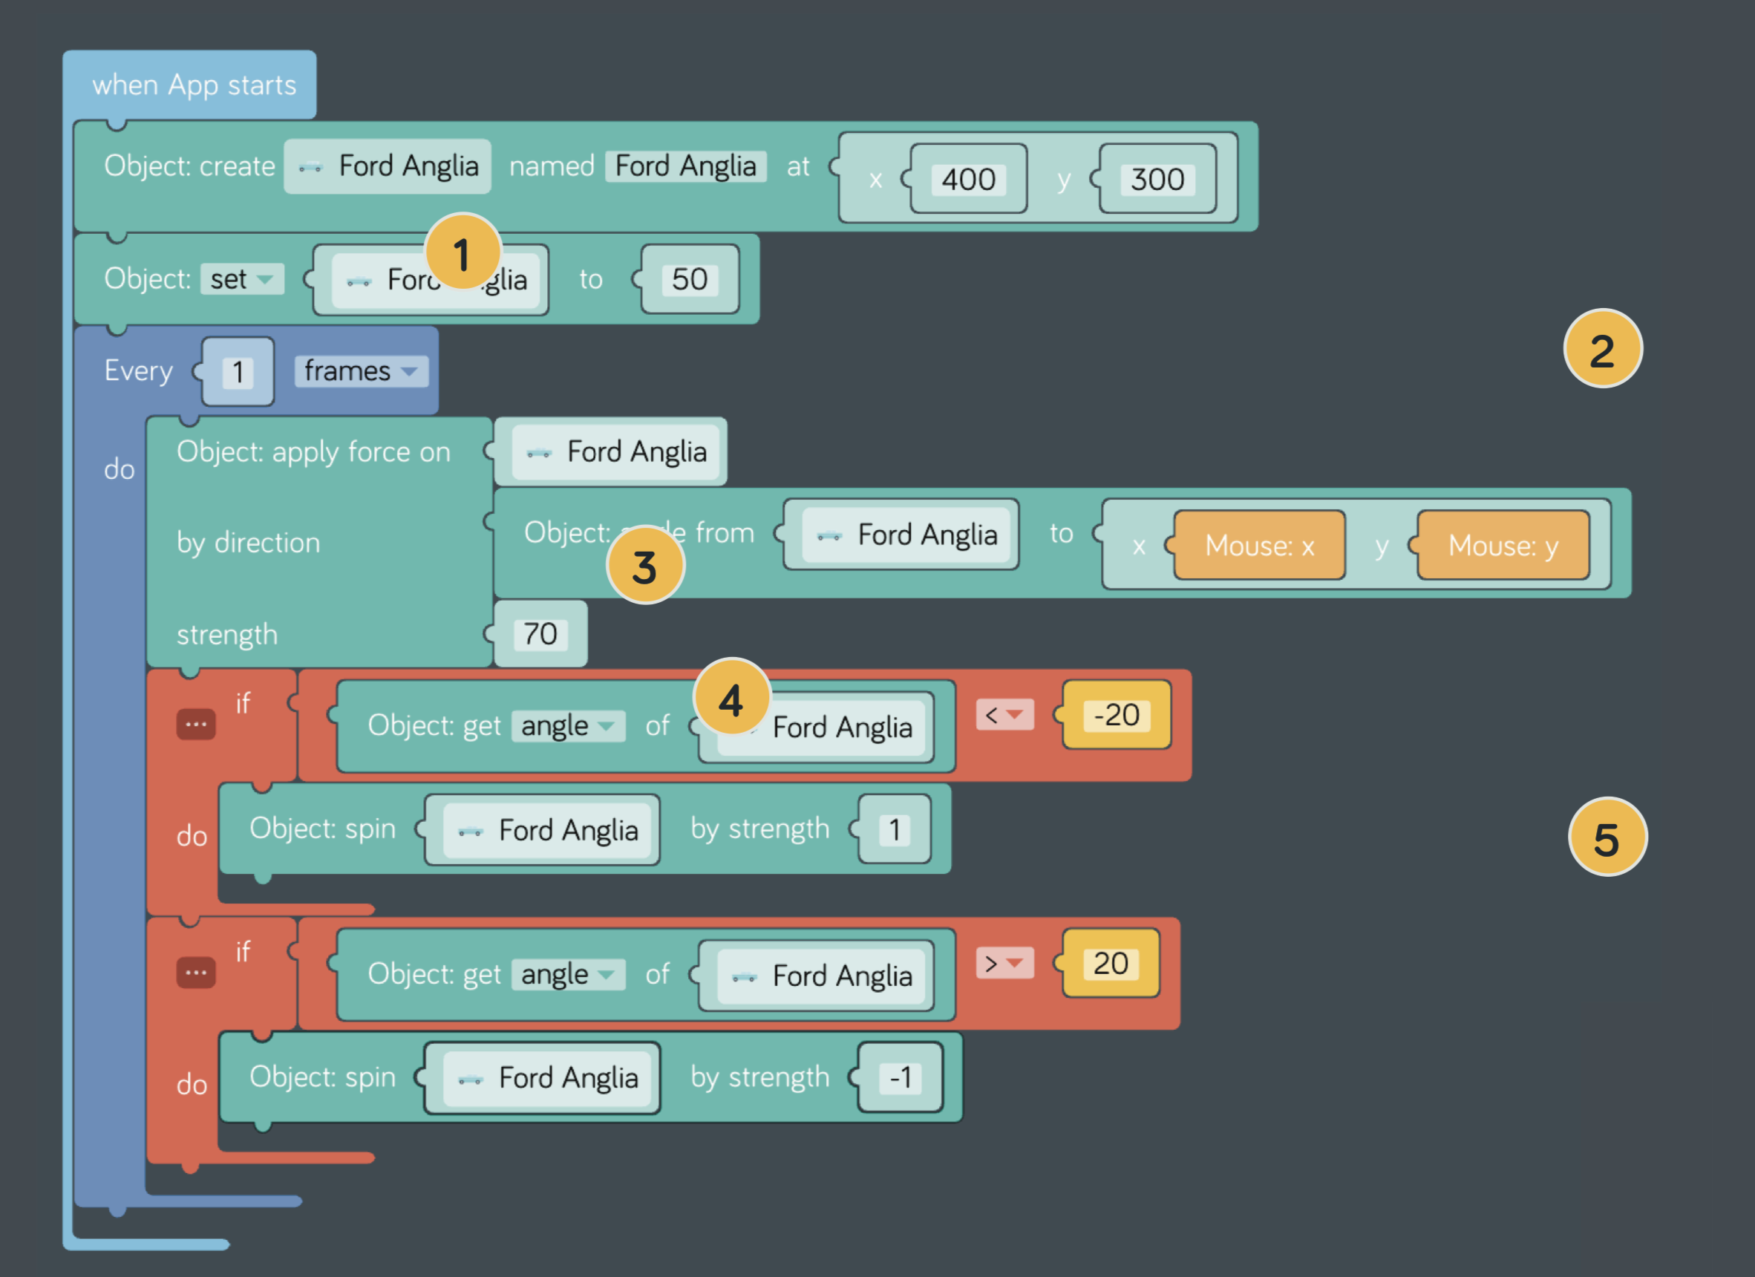
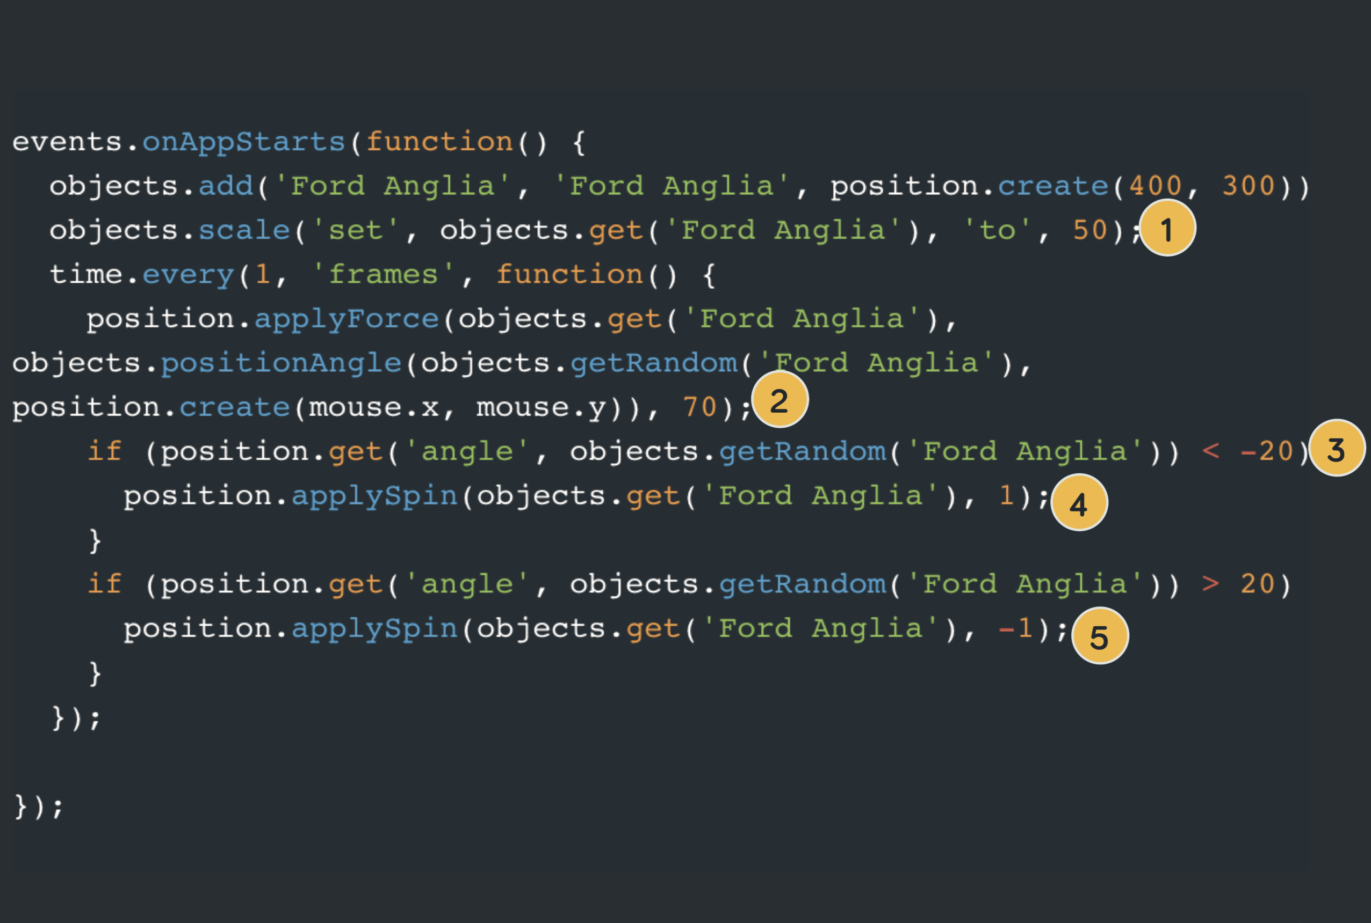
Control the Flying Car

